Slide 1



Nutrition Risk and Trophic Feeding: What Does It Mean?
Daren K. Heyland
Professor of Medicine
Queen’s University, Kingston General Hospital
Kingston, ON Canada

Slide 2
Learning Objectives
Review the evidentiary basis for the amount of macronutrients provided to critically ill patients
List approaches for risk assessment in the ICU setting
List strategies to improve nutritional adequacy in the critical care setting

Slide 3
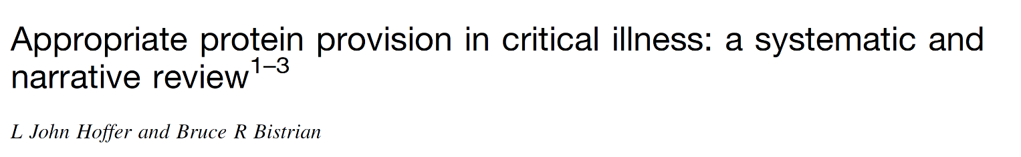
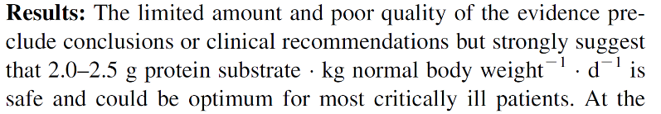
Total nr studies | 13
Randomized | 4
Nitrogen balance | 12
Turnover | 3
Body composition | 1
Amino acid profiles | 1
Outcome | 2

Slide 4
Recent Statements About the Value of Artificial Nutrition
“Our results suggest that, irrespective of the route of administration, the amount of macronutrients administered early during critical illness may worsen outcome.”
Casaer Am J Respir Crit Care Med 2013;187:247–255
“The most notable findings, however, were that loss of muscle mass not only occurred despite enteral feeding but, paradoxically, was accelerated with higher protein delivery..”
Batt JAMA Published online October 9, 2013
“Avoid mandatory full caloric feeding in the first week but rather suggest low dose feeding (e.g., up to 500 calories per day), advancing only as tolerated (grade 2B)..”
SSC Guidelines CCM Feb 2013

Slide 5

What is the optimal amount of protein/calories in the critically ill?

Slide 6
What is the evidence that exogenously administered amino acids/protein favorably impacts clinical outcomes?

Slide 7
Impact of Protein Intake on
60-day Mortality
Data from 2828 patients from 2013 International Nutrition Survey
 | Patients in ICU ≥ 4 d
Variable | 60-Day Mortality, Odds Ratio (95% CI)
 |  | Adjusted¹ | Adjusted²
Protein Intake (Delivery > 80% of prescribed vs. < 80%) |  | 0.61 (0.47, 0.818) | 0.66 (0.50, 0.88)
Energy Intake (Delivery > 80% vs. < 80% of Prescribed) |  | 0.71 (0.56, 0.89) | 0.88 (0.70, 1.11)
¹ Adjusted for BMI, Gender, Admission Type, Age, Evaluable Days, APACHE II Score, SOFA Score
² Adjusted for all in model 1 plus for calories and protein
Nicolo JPEN 2015

Slide 8
Rate of Mortality Relative to Adequacy of Protein and Energy Intake Delivered
Heyland JPEN 2015

Slide 9

More Protein Associated with Improved Survival!
If you feed them (better!)
They will leave (sooner!)

Slide 10
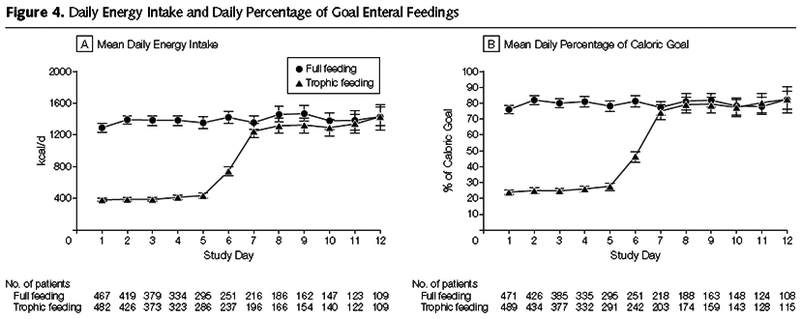
Initial Tropic vs. Full EN in Patients with Acute Lung Injury
The EDEN randomized trial
Rice TW, et al. JAMA. 2012;307(8):795-803.

Slide 11
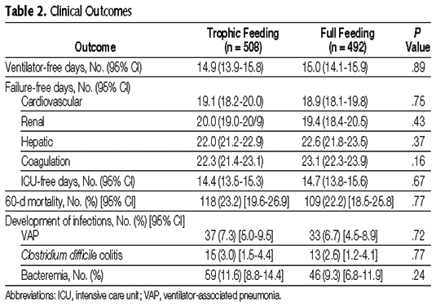
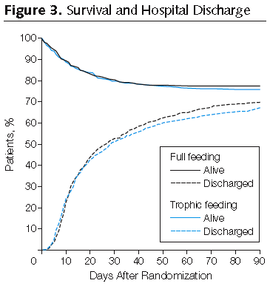
Initial Tropic vs. Full EN in Patients with Acute Lung Injury
The EDEN randomized trial
Rice TW, et al. JAMA. 2012;307(8):795-803.

Slide 12
SHOULD WE SYSTEMATICALLY UNDERFEED ALL ICU PATIENTS?

Slide 13
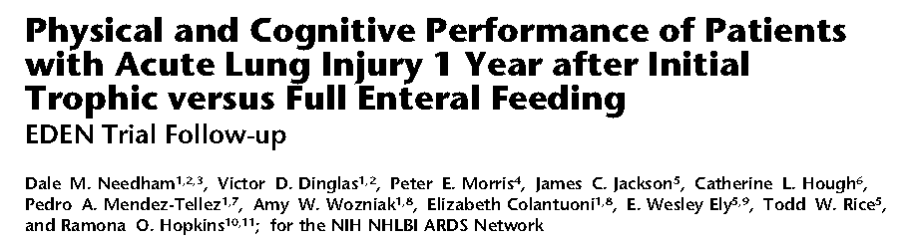
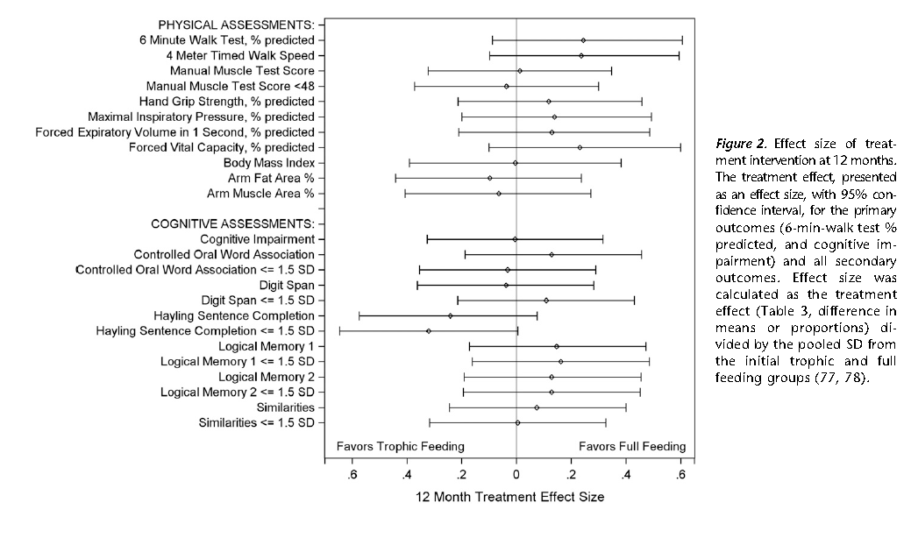

Slide 14
Nutritional Adequacy and Long-term Outcomes in Critically Ill Patients Requiring Prolonged Mechanical Ventilation
Sub study of the REDOXS study
302 patients survived to 6-months follow-up and were mechanically ventilated for more than eight days in the intensive care unit were included.
Nutritional adequacy was obtained from the average proportion of prescribed calories received during the first eight days of mechanical ventilation in the ICU.
HRQoL was prospectively assessed using Short-Form 36 Health Survey (SF-36) questionnaire at three-months and six-months post ICU admission.
Wei CCM 2015

Slide 15
Estimates of Association Between Nutritional Adequacy and SF-36 Scores
SF-36 |  | Adjusted Estimate* (95% CI) | p-value
Physical Functioning | 3-month (n=179) | 7.29 (1.43, 13.15) | 0.02
 | 6-month (n=202) | 4.16 (-1.32, 9.64) | 0.14
Role Physical | 3-month (n=178) | 8.30 (2.65, 13.95) | 0.004
 | 6-month (n=202) | 3.15 (-2.25, 8.54) | 0.25
Physical Component Scale | 3-month (n=175) | 1.82 (-0.18, 3.81) | 0.07
 | 6-month (n=200) | 1.33 (-0.65, 3.31) | 0.19
*Every 25% increase in nutritional adequacy; adjusted for age, APACHE II score, baseline SOFA, Functional Comorbidity Index, admission category, primary ICU diagnosis, body mass index, and region
Wei CCM 2015

Slide 16
So if we trophic feeds x days, it is possible that we are harming some ICU patients, particularly those with long ICU stays?

Slide 17
Early vs. Late Parenteral Nutrition in Critically ill Adults
4620 critically ill patients
Randomized to early PN
  Rec’d 20% glucose 20 ml/hr then PN on day 3
OR late PN
  D5W IV then PN on day 8
All patients standard EN plus ‘tight’ glycemic control
Results:
Late PN associated with
  6.3% likelihood of early discharge alive from ICU and hospital
  Shorter ICU length of stay (3 vs 4 days)
  Fewer infections (22.8 vs 26.2 %)
  No mortality difference
Casaer NEJM 2011

Slide 18
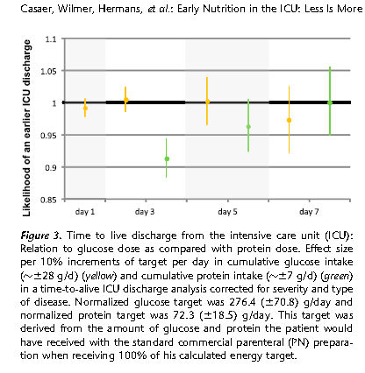
Early Nutrition in the ICU: Less is more!
Post-hoc analysis of EPANIC
Indication bias:
1) patients with longer projected stay would have been fed more aggressively; hence more protein/calories is associated with longer lengths of stay. (remember this is an unblinded study).
2) 90% of these patients are elective surgery. there would have been little effort to feed them and they would have categorically different outcomes than the longer stay patients in which their were efforts to feed
Protein is the bad guy!!
Casaer Am J Respir Crit Care Med 2013;187:247–255

Slide 19
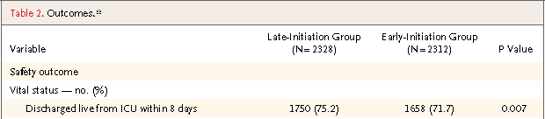


Early vs. Late Parenteral Nutrition in Critically ill Adults
Casaer NEJM 2011

Slide 20
Early vs. Late Parenteral Nutrition in Critically ill Adults
? Applicability of data
  No one give so much IV glucose in first few days
  No one practice tight glycemic control
Right patient population?
  Majority (90%) surgical patients (mostly cardiac-60%)
  Short stay in ICU (3-4 days)
  Low mortality (8% ICU, 11% hospital)
  >70% normal to slightly overweight
Not an indictment of PN
  Clear separation of groups after 2-3 days
  Early group only rec’d PN on day 3 for 1-2 days on average
  Late group –only ¼ rec’d any PN
Casaer NEJM 2011

Slide 21
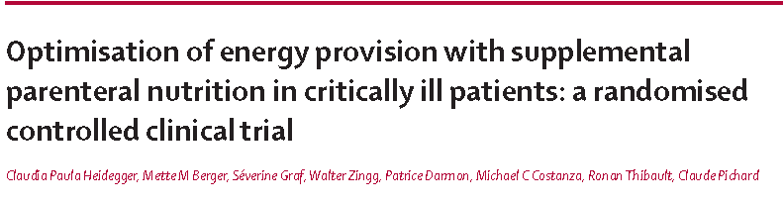
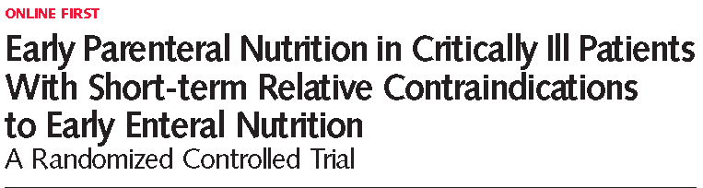
Lancet Dec 2012
Doig, ANZICS, JAMA May 2013

Slide 22
The Nephroprotect Study
RCT short-term daily IV aa on kidney function in critical illness, compared to standard care.
Unblinded
All patients expected to remain 48 hrs; excluded patients with AKI
Max protein intake total of 2.0 gm/kg/day (IBW)
More patient in Intervention group with:
  Higher APACHE II severity of illness scores (20.2 ± 6.8 vs. 21.7 ± 7.6, P = 0.02)
  pre-existing renal dysfunction (29/235 vs. 44/239, P = 0.07)
Doig Int Care Med 2015

Slide 23
The Nephroprotect Study
Doig Int Care Med 2015

Slide 24
The Nephroprotect Study
P=0.004
No difference in any other renal or clinical outcome
No impact on survival or HRQOL/Physical function
Doig Int Care Med 2015

Slide 25
So how do we put this all together?

Slide 26
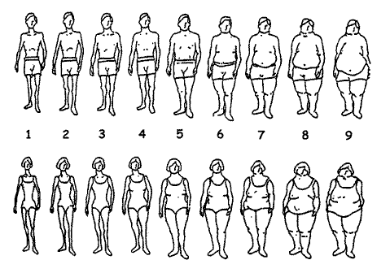
ICU patients are not all created equal…should we expect the impact of nutrition therapy to be the same across all patients?

Slide 27
Not all ICU Patient the same!
Low Risk
  34 year former football player,
  BMI 35
  otherwise healthy
  involved in motor vehicle accident
  Mild head injury and fractured R leg requiring ORIF
High Risk
  79 women
  BMI 35
  PMHx COPD, poor functional status, frail
  Admitted to hospital 1 week ago with CAP
  Now presents in respiratory failure requiring intubation and ICU admission

Slide 28
A Conceptual Model for Nutrition Risk Assessment in the Critically Ill
Acute
Reduced po intake
pre ICU hospital stay
Chronic
Recent weight loss
BMI?
Starvation
Nutrition Status
micronutrient levels - immune markers - muscle mass
Inflammation
Acute
IL-6
CRP
PCT
Chronic
Comorbid illness

Slide 29
The Development of the NUTrition Risk in the Critically ill Score (NUTRIC Score).
Variable | Range | Points
Age | <50 | 0
 | 50-<75 | 1
 | >=75 | 2
APACHE II | <15 | 0
 | 15-<20 | 1
 | 20-28 | 2
 | >=28 | 3
SOFA | <6 | 0
 | 6-<10 | 1
 | >=10 | 2
# Comorbidities | 0-1 | 0
 | 2+ | 1
Days from hospital to ICU admit | 0-<1 | 0
 | 1+ | 1
IL6 | 0-<400 | 0
 | 400+ | 1
AUC | 0.783
Gen R-Squared | 0.169
Gen Max-rescaled R-Squared | 0.256
BMI, CRP, PCT, weight loss, and oral intake were excluded because they were not significantly associated with mortality or their inclusion did not improve the fit of the final model.

Slide 30
The Validation of the NUTrition Risk in the Critically ill Score (NUTRIC Score)

Slide 31
The Validation of the NUTrition Risk in the Critically ill Score (NUTRIC Score)

Slide 32
The Validation of the NUTrition Risk in the Critically ill Score (NUTRIC Score)
Interaction between NUTRIC Score and nutritional adequacy (n=211)*
P value for the interaction=0.01
Heyland Critical Care 2011, 15:R28

Slide 33
External Validation of NUTRIC Score in
Large International Database
>2800 patients from >200 ICUs
Protein
Calories
^Faster time-to-discharge alive with more protein and calories ONLY in the high NUTRIC group
Compher (in submission)

Slide 34
More Protein is Better!
Particularly in ‘High-risk’ patients
If you feed them (better!)
They will leave (sooner!)

Slide 35
So how do we optimally deliver protein to critically ill patients?

Slide 36
Current Practice
Results of 2014 INS
site
All US sites
All sites
60%
55%
48%
63 sites in US (Sister Sites)
186 sites worldwide
Notes:
Add figure from Site report from top US site, deidentified.

Slide 37
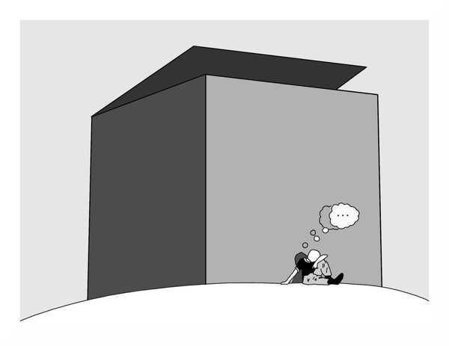
Can we do better?
The same thinking that got you into this mess won’t get you out of it!

Slide 38

The Efficacy of Enhanced Protein-Energy Provision via the Enteral Route in Critically Ill Patients:
The PEP uP Protocol!
Different feeding options based on hemodynamic stability and suitability for high volume intragastric feeds.
In select patients, we start the EN immediately at goal rate, not at 25 ml/hr.
We target a 24 hour volume of EN rather than an hourly rate and provide the nurse with the latitude to increase the hourly rate to make up the 24 hour volume.
Start with a semi elemental solution, progress to polymeric
Tolerate higher GRV threshold (300 ml or more)
Motility agents and protein supplements are started immediately, rather than started when there is a problem.
A Major Paradigm Shift in How we Feed Enterally
Heyland Crit Care 2010;
see www.criticalcarenutrition.com for more information on the PEP uP collaborative

Slide 39
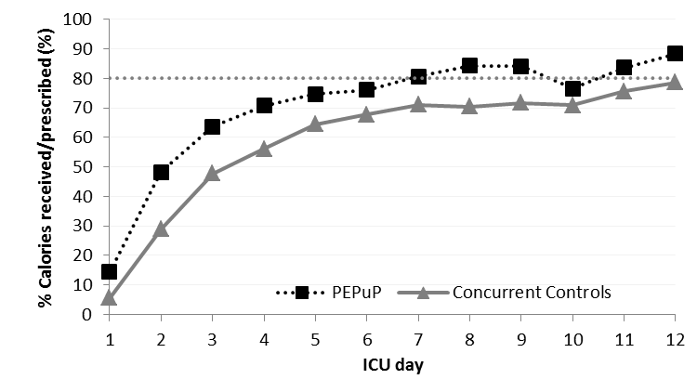
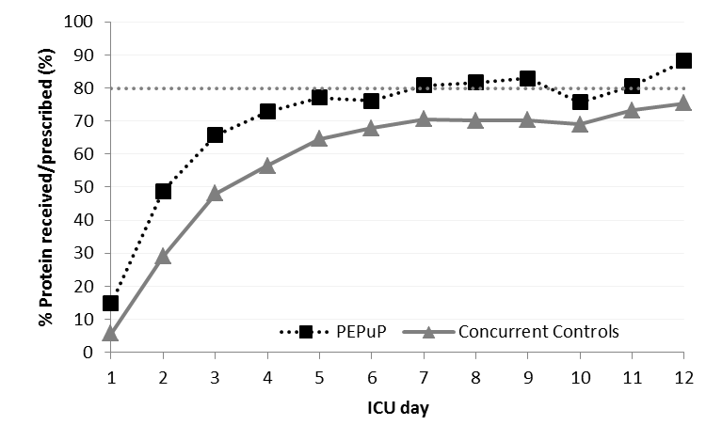
Results of the Canadian PEP uP Collaborative
Results of 2013 International Nutrition Survey
Heyland JPEN 2014

Slide 40
More Protein is Better!
Particularly in ‘High-risk’ patients
If you feed them (better!)
They will leave (sooner!)

Slide 41
The Protein TOP UP Trial
Extra protein for 7-10 days
Primary Outcome
ICU patients
R
Stratified by:
Site
BMI
Med vs Surg
Fed enterally
Activity or performance based metric
Nutric >5
Standard underfeeding

Slide 42
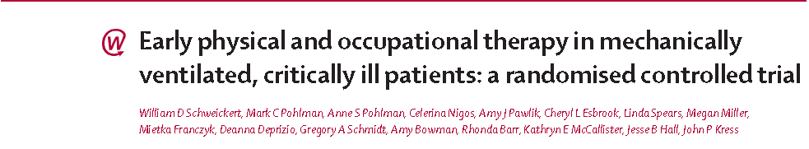
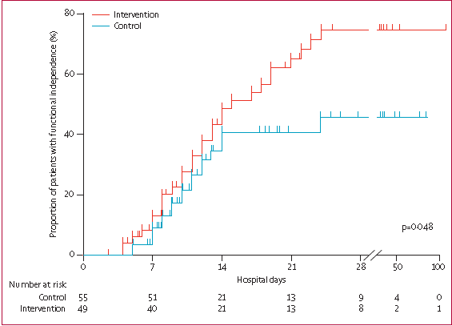

Lancet 2009;273:

Slide 43
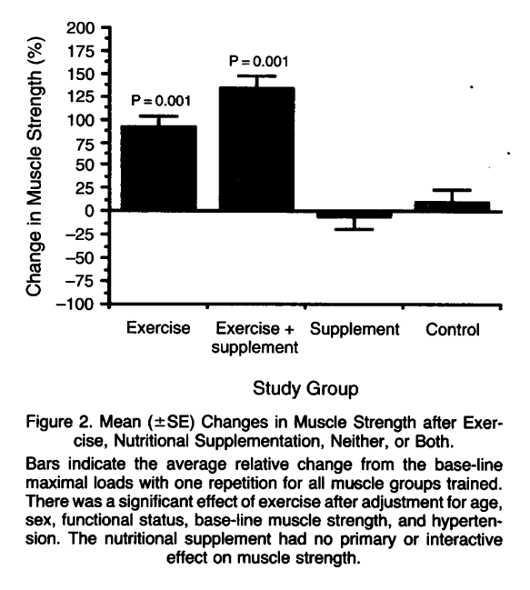
Exercise Training and Nutritional Supplementation for Physical Frailty in Very Elderly People
Fiatarone, NEJM 1994;330:1769-1775.

Slide 44
Nutrition and EXercise Interventional Study in critically ill patients
The NEXIS study
Extra protein for 7-10 days
And early mobility/exercise
Primary Outcome
ICU patients
R
Stratified by:
Site
BMI
Med vs Surg
Fed enterally
Activity or performance based metric
Nutric >5
Standard underfeeding
and bedrest

Slide 45
In Conclusion
Controversy exists regarding optimal protein and amino acid doses in critically ill patients.
Overall, weight of evidence support increased protein administration
Not all patients will benefit the same from optimal or high protein dosing
Further RCTs are warranted
Second generation EN feeding protocols (PEP uP) or IV amino acids or supplemental PN may be considered to optimize protein intake
May be combination of activity and optimal nutrition will result in greatest preservation of lean muscle mass and best patient-centered outcomes?

Slide 46
Questions?

